Slide 1

Welcome back!
Studio S7
Ma Chi Kin Brian
e1121386@u.nus.edu
Tele: @bmanara

Slide 2
Halfway through the Semester!

Slide 3
How has CS1101S been for you?
Notes:
(1)Create: You create, solve, and engage. Every program you've crafted is a testament to your active pursuit of knowledge. How can the creative process guide you in your learning?
(2) Experience: You've not just learned the material of Units 1 and 2; you've felt the confusion posed by a complex concept and the joy of finally mastering it. How do these experiences improve your learning?
(3) Endure: In moments of challenge, it's not just about finding a solution, but how you face the problem. How do you and your Studio mates approach obstacles? What mindset allows you to tackle these challenges and thrive?

Slide 4
Agenda for Today
Admin Matters
Quick Recap
S7 In-Class Studio Worksheet
Midterm Preparations

Slide 5
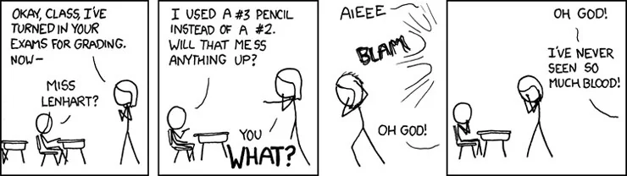
Admin Matters
Midterms!
Date & Time: 2-Oct-2024, Wednesday, 10:05AM - 11:35AM (2 Days left!)
Be there by 09:50AM latest
Come to school earlier, buses may be crowded…
Venue: MPSH-2A & MPSH-2B
Find out how to get there!
Double check your venue and sitting assignment.
Bring Student Card, 2B Pencil and Pen. Don’t forget your cheatsheet too!

Slide 6
Admin Matters
Robot Missions
Decide on our robot custodian!
Bonus XP given for your hard work and dedication to protecting the robot.
Huge box of components though, preferably someone who lives in campus…

Slide 7
QUICK
RECAP
Binary Search & BSTs
Sorting
Symbolic Processing
Streams
Notes:
*not important/assessed

Slide 8
Binary Search
Only works if our data structure is “sorted”
All numbers on the left are smaller
All numbers on the right are bigger
Given the above property, we can split the search space into half with each iteration.
If problem size is N = 2^{k}, it takes k steps to get to size 1 (solved)
Runtime: ?

Slide 9
Binary Search
Only works if our data structure is “sorted”
All numbers on the left are smaller
All numbers on the right are bigger
Given the above property, we can split the search space into half with each iteration.
If problem size is N = 2^{k}, it takes k steps to get to size 1 (solved)
Runtime: O(log₂(N))

Slide 10
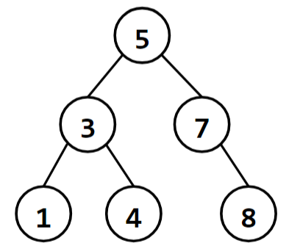
Binary Search Trees (BST)
Our special data structure that makes full use of Binary Search!
A BST is a binary tree where
all entries in the left subtree are smaller than the entry, and
all entries in the right subtree are bigger than the entry.
Should be familiar with this since we used it in the
Mission “Search and Rescue”!

Slide 11
Sorting
Given: (Input)
List xs of elements, and some total order.
Wanted: (Output)
A permutation of xs such that each element is greater than or equal to the previous one, with respect to the total order.
Only comparisons allowed
Only <, >, <=, >=, === or !== allowed

Slide 12
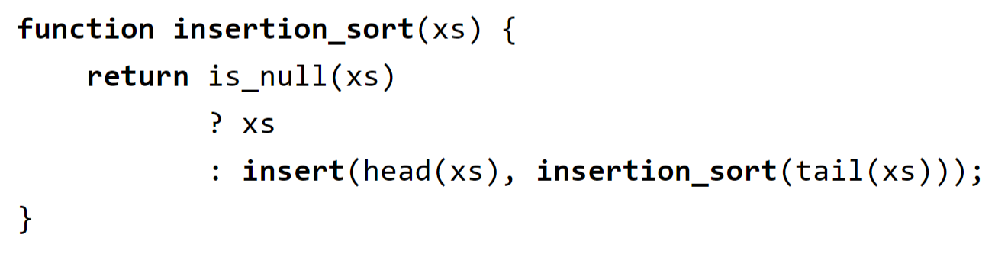
Insertion Sort
Sort the tail of given list xs using wishful thinking.
Insert the head in the right place.

Slide 13
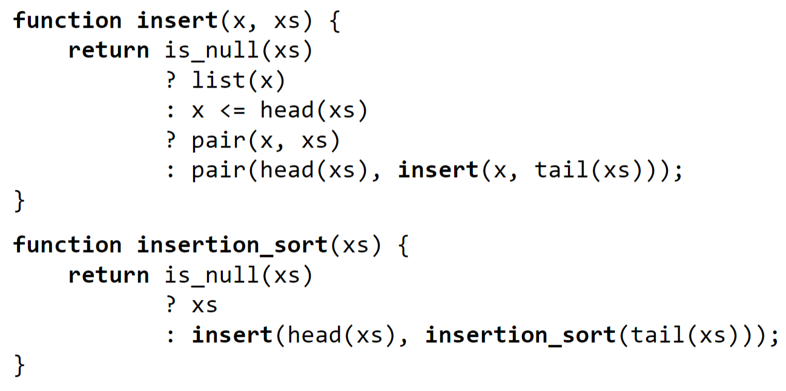
Insertion Sort
Sort the tail of given list xs using wishful thinking.
Insert the head in the right place.
Order of Growth?
Notes:
Intuitively, sort the tail of the list first, then find the spot where the head belongs in the sorted list.

Slide 14
Insertion Sort
Sort the tail of given list xs using wishful thinking.
Insert the head in the right place.
Order of Growth:
O(n²)

Slide 15
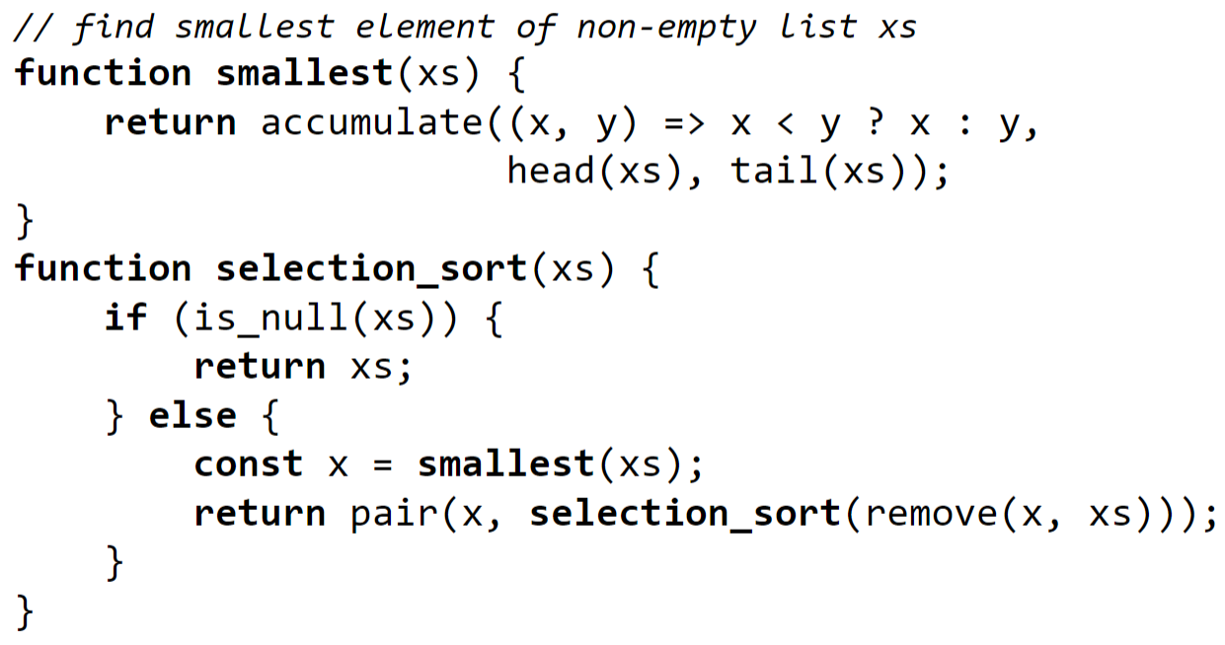
Selection Sort
Find the smallest element x and remove it from the list
Sort the remaining list, put x in front.
Order of Growth?
Notes:
Intuitively, find the smallest element and put it at the front. Sort the rest of the list without the smallest element recursively.

Slide 16
Selection Sort
Find the smallest element x and remove it from the list
Sort the remaining list, put x in front.
Order of Growth:
O(n²)

Slide 17
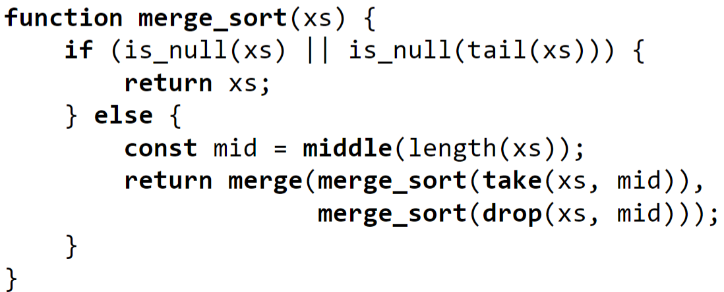
Merge Sort
Split the list in half, sort each half using wishful thinking
Merge the sorted lists together
Notes:
Note the base case!!!
What does the merge function do?

Slide 18
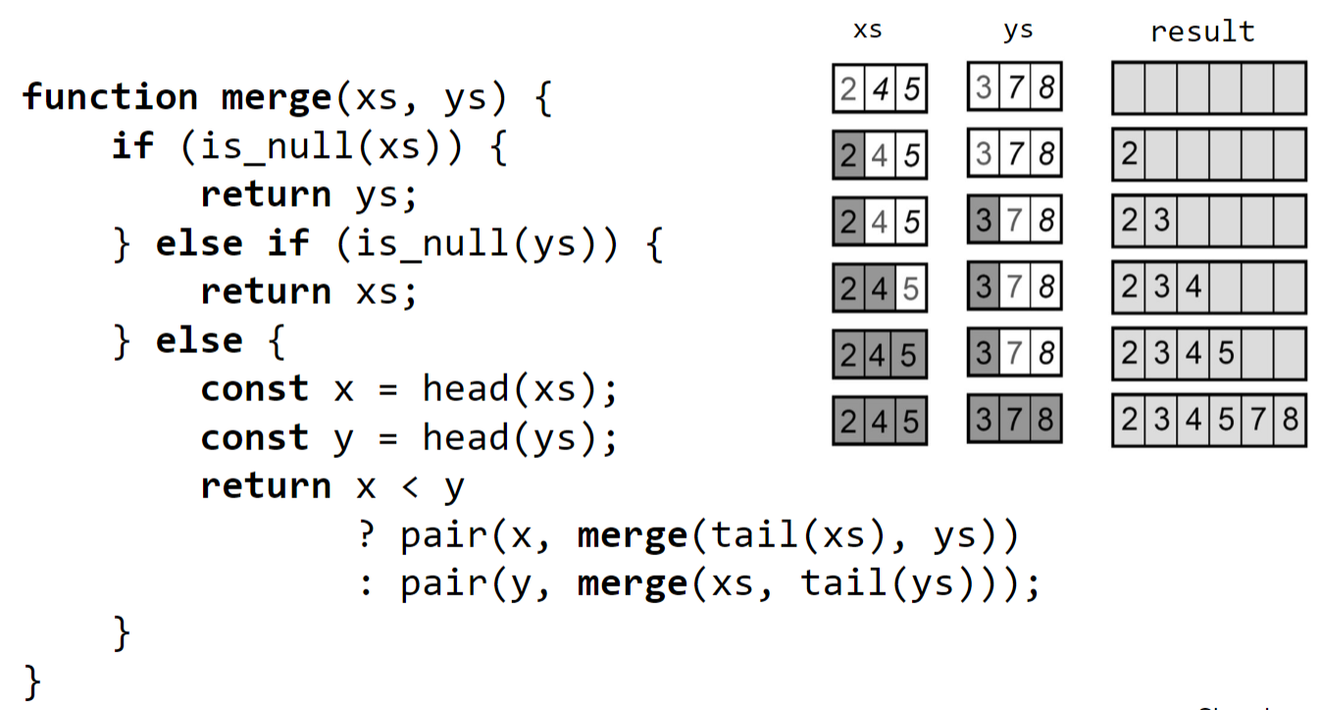
Merge Sort
How does the merge function work?
Order of Growth?

Slide 19
Merge Sort
How does the merge function work?
Order of Growth:
O(nlog(n))

Slide 20
Quick Sort
Seen in Mission “Sorting Things Out”
Order of Growth in Time?
Notes:
Go through using the mission as example.

Slide 21
Symbolic Processing
Representing functions/expressions with Data Structures, instead of our usual way of directly implementing using function declarations and lambda expressions.
All these functions provide an abstraction of the data structure
“Shield” the rest of the program from implementation of data structure
Hard to grasp this, especially with the limited exposure of Data Structures in CS1101S currently…
Refer to SICP Textbook and Lecture Slides and ask in telegram if there are any issues with this!

Slide 22
Streams
Main Idea:
Delayed Evaluation!
Functions allow us to describe an activity without actually doing it.
Delayed Lists
Our pairs contain a data item as head, but a function as tail. This function can be activated whenever needed
Streams are “Lazy” Lists!

Slide 23
Streams
Stream Discipline
A stream is either the empty list, or a pair whose tail is a nullary function that returns a stream.
What is a nullary function?

Slide 24
Streams
Stream Discipline
A stream is either the empty list, or a pair whose tail is a nullary function that returns a stream.
What is a nullary function?
A function that takes no arguments.

Slide 25
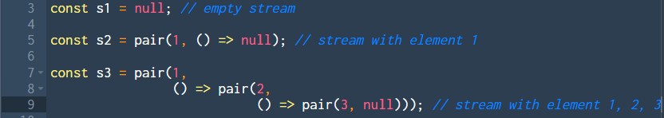
Streams
Examples of Streams:

Slide 26
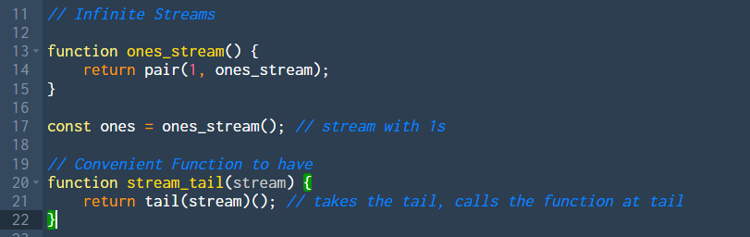
Infinite Streams
Examples of Infinite Streams:
Notes:
Introduce stream_tail as well

Slide 27
Infinite Streams
Examples of Infinite Streams:

Slide 28
Useful Functions in Stream
stream_tail(s)
stream_ref(s, n)
stream_map(f, s)
stream_map(p, s)
And more in https://docs.sourceacademy.org/STREAMS/index.html (Supported in Source 3)
Notes:
Introduce stream_tail as wel

Slide 29
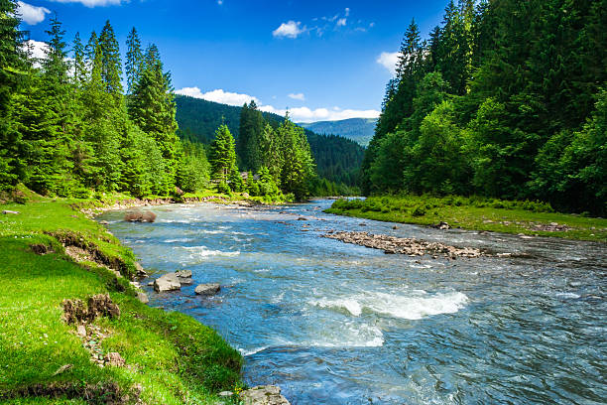
Streams
S7 In-class Studio Sheet

Slide 30
Midterm Questions
“AHHHHH MIDTERMS ARE COMING AND IM NOT READY” - Me

Slide 31
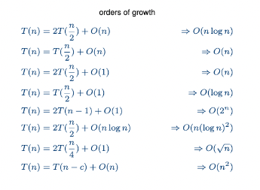
Orders of Growth
Before we discuss about midterm question.
For Orders of Growth questions, if all else fails….
(Credits: https://github.com/jovyntls/cheatsheets/blob/master/CS2040S/cs2040s-cheatsheet.pdf)

Slide 32
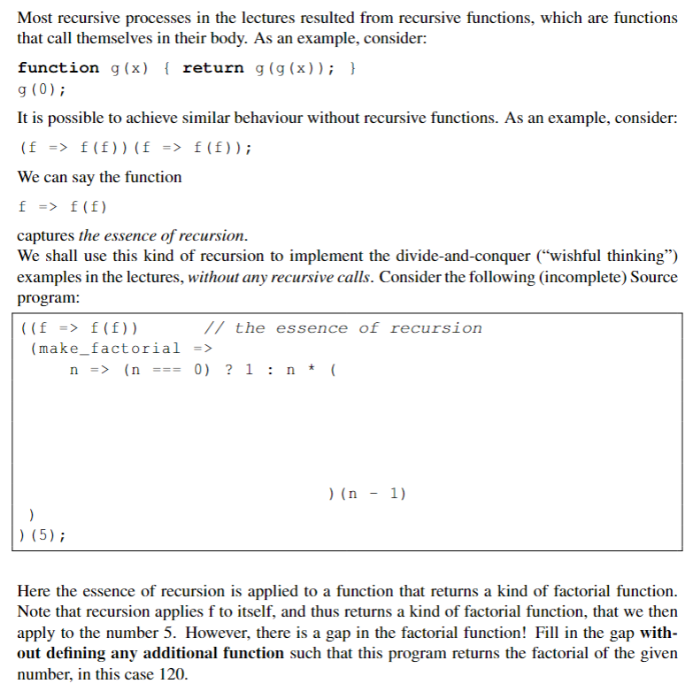
AY 17/18 Midterm Q7

Slide 33
All the best for your Midterms!
Slides will be uploaded to the google drive.

